Slide 1



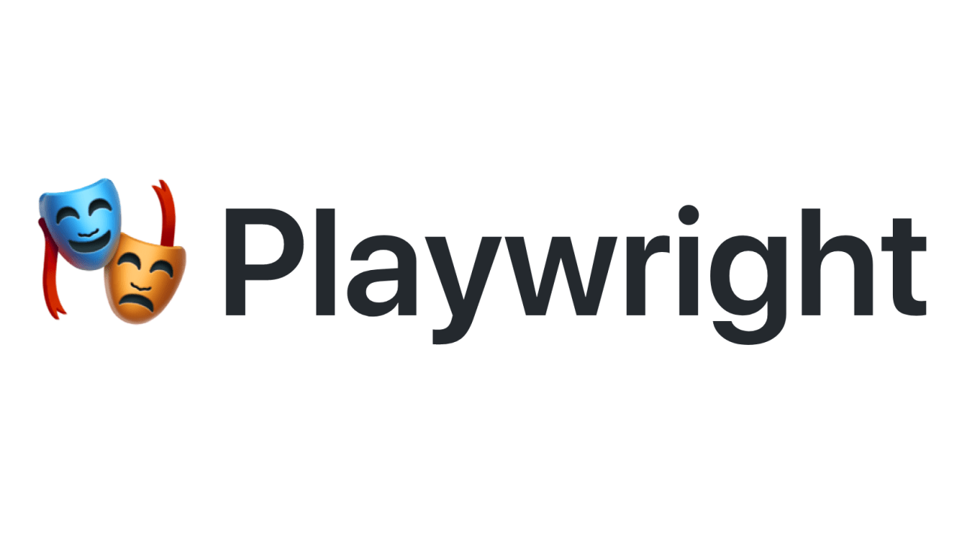
Learning PlayWright (Java)
E2E Web Testing with Playwright(Java)
Pramod Dutta
SDET Manager
Understanding Playwright First Script(Java) - Part 2

Slide 2
Agenda
Let’s understand Playwright
Browser
Browser Context
Launch a Test case Parallel
Automate a Quick Test case #2.
Playwright vs Cypress

Slide 3
Playwright Core.

Slide 4
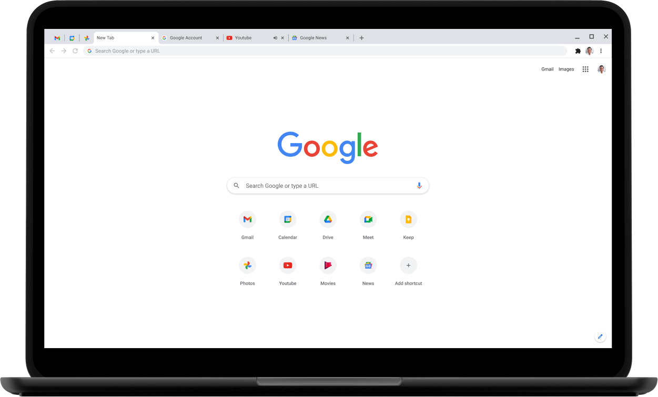
Playwright?
Browser
Browser Context
Page
Navigation
browser - chrome.launch() -> context -> browser.newContext() -> page -> context.newPage() page.Navigation

Slide 5
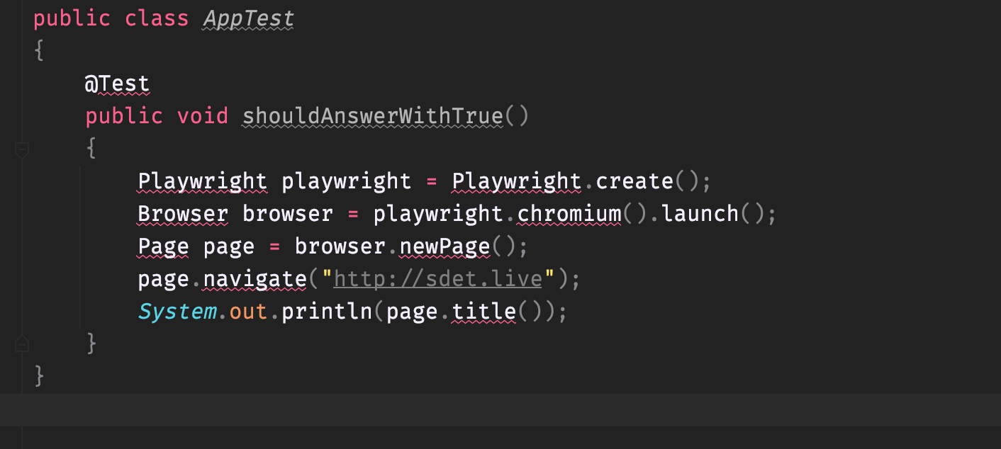
CODE Of Playwright
Playwright playwright = Playwright.create();

Slide 6
Playwright Commands
page.screenshot(new Page.ScreenshotOptions().setPath(Paths.get("example.png")));

Slide 7
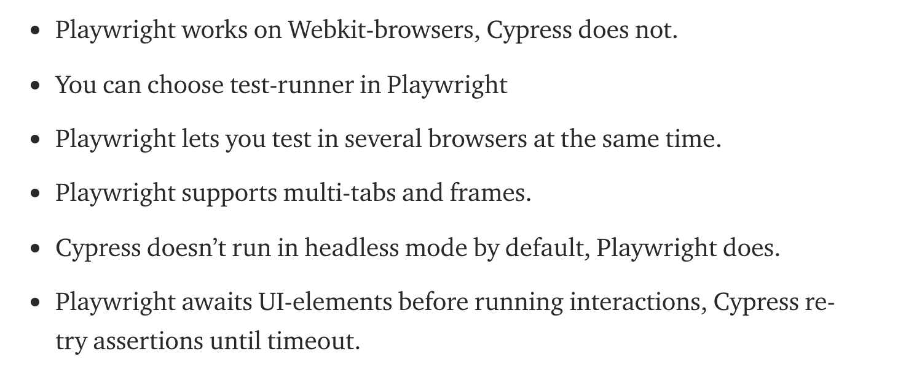
Playwright vs Cypress
https://medium.com/sparebank1-digital/playwright-vs-cypress-1e127d9157bd

